Slide 1

Project Buzy cart (b2b Electronic Dealing website) case study
INTRODUCTION
In the electronics products sectors, manufacturers and importers are adapting to fast-changing business conditions through
innovative product development, new technologies, supply chain enhancements and business acquisitions. Busy Cart’s
electronic Products group helps clients deal with business purchases.
Busy Cart sells electronics Products to other Businesses and distributors. It is a B2B company. The company currently has
10 offices in the India, and have been selling Electronics Products in other countries also, like US, UK and Australia
through online sales on its website. The fulfilment of delivery is done by local distribution centers.
The company is planning to expand by establishing new offices because the sales growth in these countries has been
increasing over the last 3 years. The locations are:
Washington, USA
Jaipur, India
Cannes, France
Berlin, Germany
Cape Town, Australia

Slide 2
Case study
(Defined)
Obstacles:
Logistic management in B2B.
Adding new Inventry and new location management.
Stock keeping unit (SKU) management.
Product vendor management.
Product pricing and price deadline management.
Tansaction (paid/unpaid) management.
Customer/Vendor Data integrity.
Shipment and returned product management.

Slide 3
Case study
(Defined)
Resolutions:
Maintaning a Definite data base will resolve(Logistic,customer and vendor) issue.
Maintaning a team for Market survey and product pricing accordingly.
Transaction data (Paid/unpaid) should be maintained properly and dealines should be maintained(third party:Paypal,Razor pay)
Robust data table should be maintain so we can add new inventory across the globe and run the business on same data table.
Shipment and returned product should aslo be resolved by third party company(Blue dart , Xpress bees etc);
Easy and Robust interface should be desined for the customer/vendors so they can easily get there product and also relate their requirement.

Slide 4
Data table (Architecture)

Slide 5
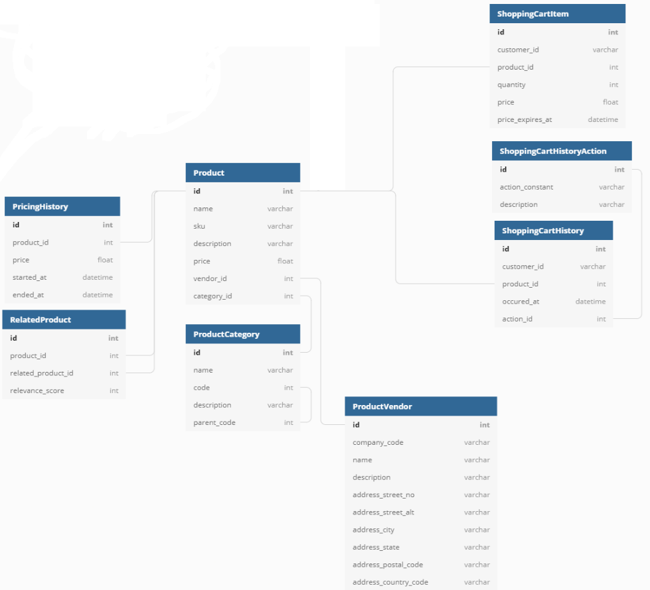
Product Vendor ,Product and shopping cart
(Structure)

Slide 6
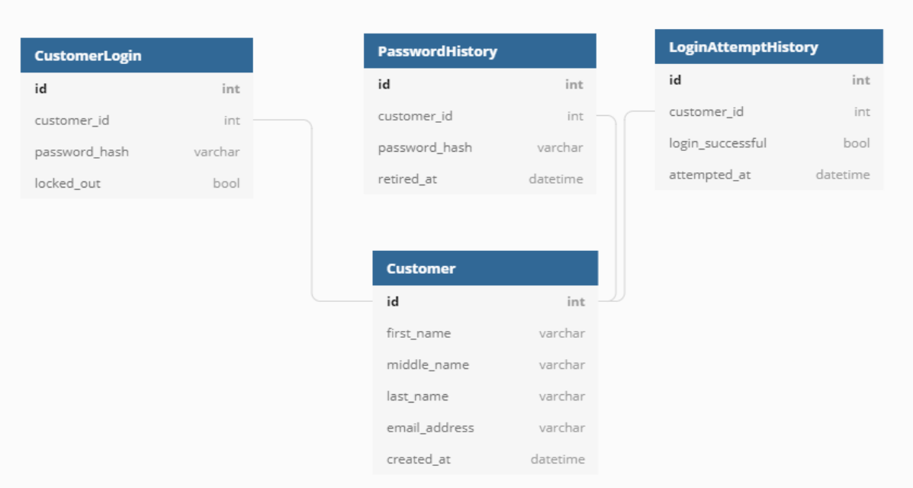
Customer Authorization and Login
(Structure)

Slide 7
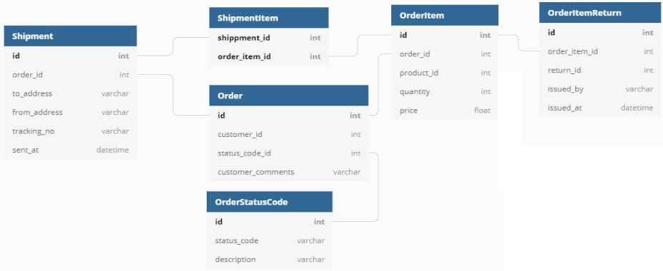
Shipment , Order and Order return
(Structure)

Slide 8
SQL Code

Slide 9
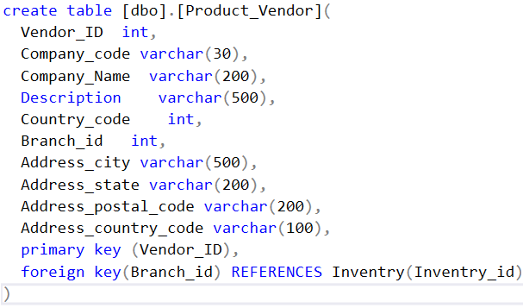
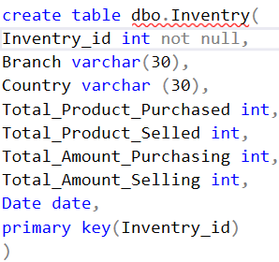
Table Creation
Product_vendor table:
Inventry table:
Relation between Inventry And Product_vendor table

Slide 10
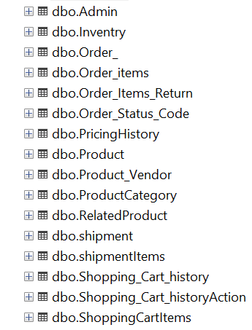
Entire table
Accordingly All table are in realtionship with the primary key of their parent table and referenced with their foreign key.

Slide 11
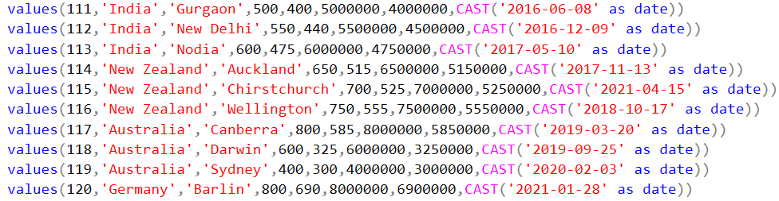
Table insertion

Slide 12
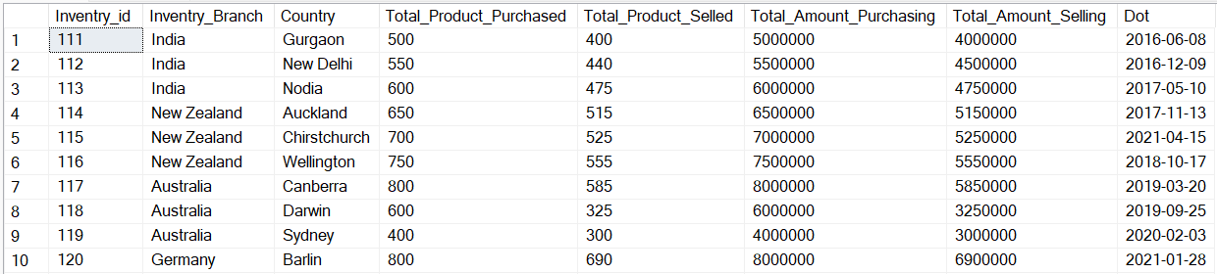
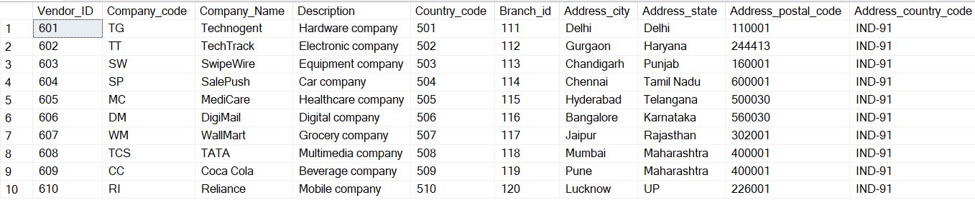
Table view
Foreign key references to Primary key

Slide 13
Thank you

